Slide 1
Kinematic Analysis, Modeling, and Inverse Kinematics for a 6-DOF Manipulator
EN.535.630.81
Theo Dardia | Savari Datta | Demetrius Rauck

Slide 2
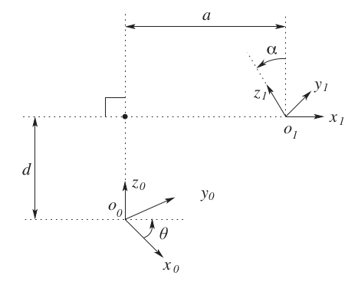
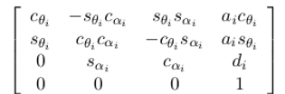
Denavit-Hartenberg (DH) Parameters
We can define a transformation from one link (prismatic or revolute) to another using four parameters
a – link length
α – link twist
d – link offset
θ – joint angle
Since the homogeneous transformation matrix is a function of a single variable (the link can either be revolute or prismatic), three of the above four quantities are constant for a given link, while the fourth parameter, θ for a revolute joint and d for a prismatic joint, is the joint variable (denoted by q).
Coordinate Transformation from link 0 to link 1
General Homogeneous Transformation Matrix for link i to link i+1

Slide 3

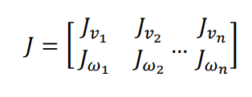
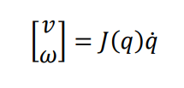

Forward Kinematics & The Jacobian
Using the resulting homogeneous transformation matrices derived from the DH parameters (joint variables) of a manipulator, we can also describe the motion (linear and angular velocities) of its links in the global frame
The 6xn Jacobian (J) describes the kinematic transformations from states (positions and velocities) in the body coordinate system to the global system
Linear and angular Jacobians for revolute joint
Linear and angular Jacobians for a prismatic joint
Construction of the 6xn Jacobian
n: number of links
Equation relating the Jacobian and the time derivatives of the joint variables to the linear and angular velocity of a link

Slide 4
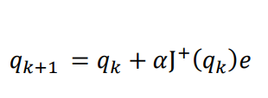

Inverse Kinematics of a 6-DOF
For our N-Linked 6-DOF manipulator, solving the inverse kinematics using a closed form solution is unpractical
An iterative method was used to update the joint variables until the error relative to the desired state was negligible
The convergence the joint variable solutions can lead to some error in calculation. There are methods of mitigation, like adding damping
However, mitigating such instabilities is unnecessary since the project is fairly straightforward
Psuedo-Jacobian (inverse of a non-square matrix)
Iterative solution for the desired joint variables
𝛼 is a step size parameter

Slide 5




Equations of Motion
In order to explicitly describe the relationship between force and motion of our 6-DOF robotic manipulator, the Lagrangian of the system must be defined
Total kinetic energy of the system
m: link mass
I: interia tensor of a link
R: rotational component of the homogenous trans. matrix
Total gravitational potential energy of the system
m: link mass
g: gravitational constant (constant vector pointing the negative vertical direction)
rci: point of the link's center of mass
Defintion of the Lagrangian equation of motion for each set of joint variables
τ: generalized external force

Slide 6
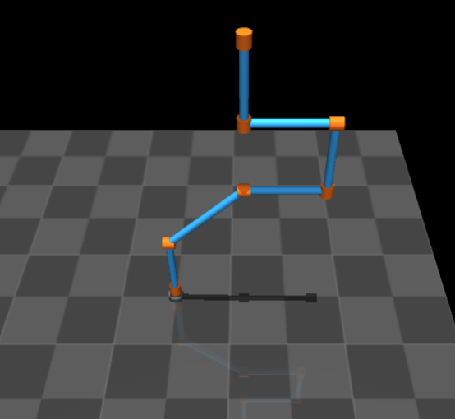
Visualizing the 6-DOF with Mujoco
MuJoCo is a user-friendly, free, and open source physics engine that constructs, renders, and animates physical simulations – perfect for visualizing our robotic manipulator
We visualized our linked manipulator using an XML template
We wrote a script that digests a DH table and returns a formatted xml template that tells the rendering engine where each link is in relation to the last link and how that link is oriented

Slide 7
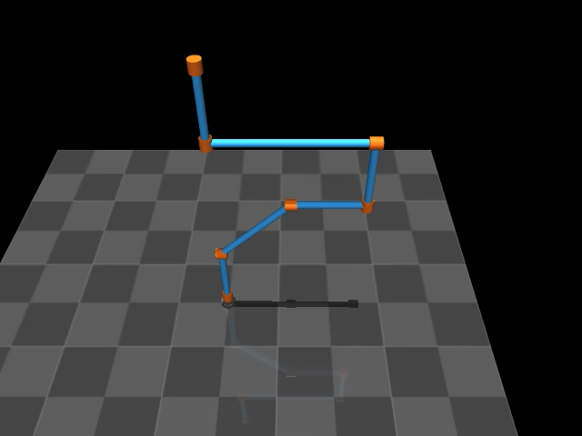
Mujoco Native Gravitational Modeling
The Mujoco Simulation automatically models gravity and its impact on the linked manipulator
The video demonstrates the motion of each joint and link due to gravity and the impact of the other links in the system

Slide 8
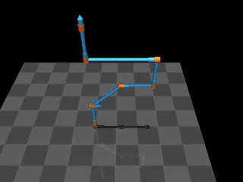
Visualizing Kinematics with Mujoco
We can also control the dynamics of the manipulator with Mujoco
Here we demonstrate the result of the rotating the first revolute joint of the system at a constant rate

Slide 9
Modeling the 6-DOF Computationally
A DH table is input to the program using symbolic variables for the revolute and prismatic links
Our script then derives analytical solutions for the equations of motions in python
The analytical solution was derived using SymPy - a library for symbolic mathematics
There are benefits to solving the system analytically (as opposed to numerically)
Only have to derive the solution once
Easier to analyze than a numerical solution

Slide 10
Deriving the Equations of Motions Forward and Inverse Kinematics
For a given DH table and we assume that the only force acting upon the system is gravity, then the equations of motion can be modeling symbolically and are calculated using the Lagrangian
Homogeneous Transform (H)
Jacobian Matrix (J)
Inertia Tensor D(q)
Christoffel symbols c(i,j,k)
Gravity vector g(q)
Calculating Homogeneous transformations, Jacobians and equations of motion symbolically also allows us to calculate the inverse kinematics of a system to drive the manipulator a specified state if such a solution exists

Slide 11
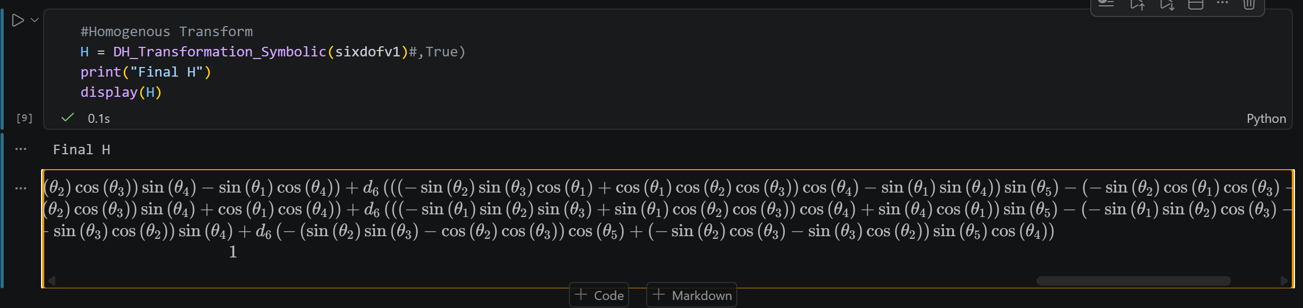
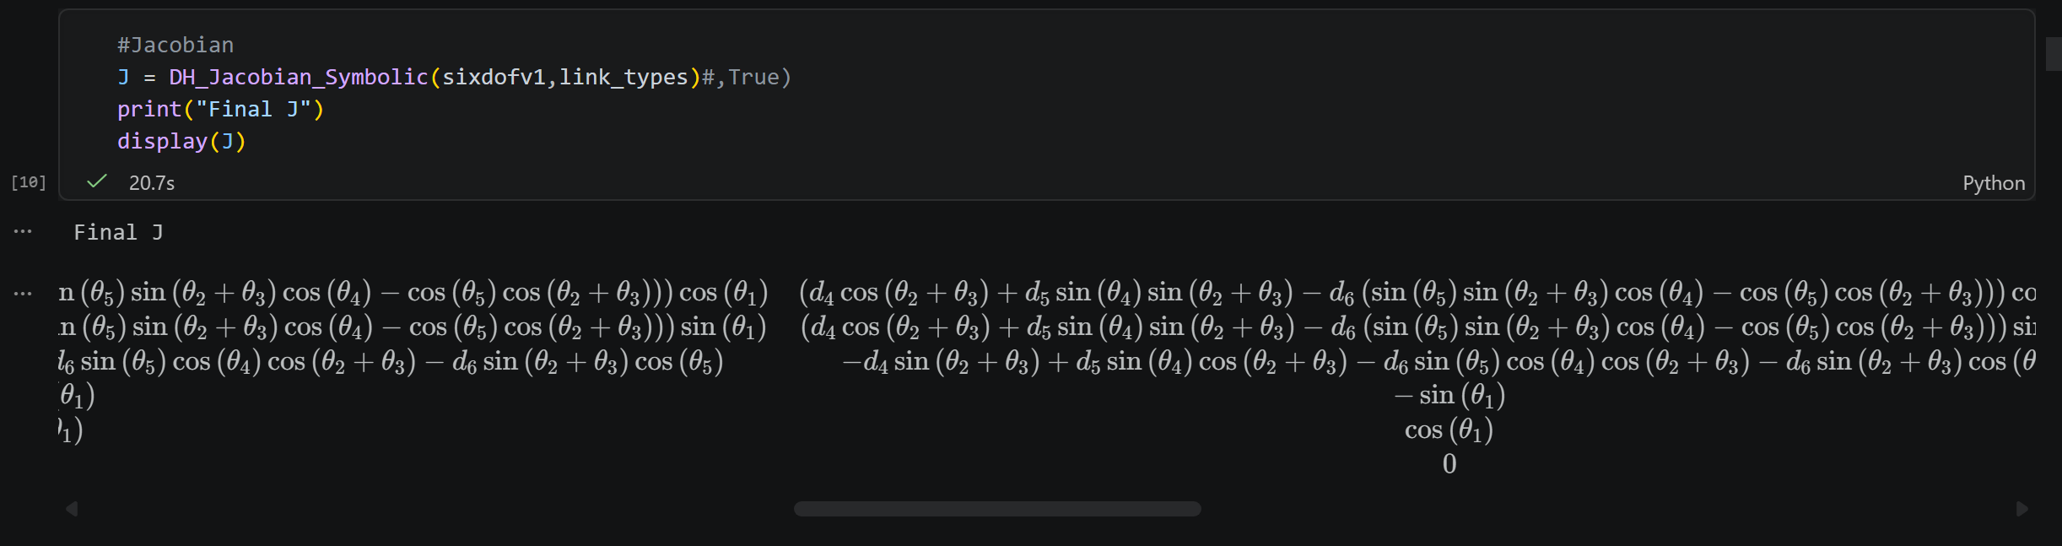
Symbolic Kinematic Equations
Symbolic inverse kinematics was too verbose given the many orientations and positions of a theoretical 6dof robot, used numerical instead

Slide 12
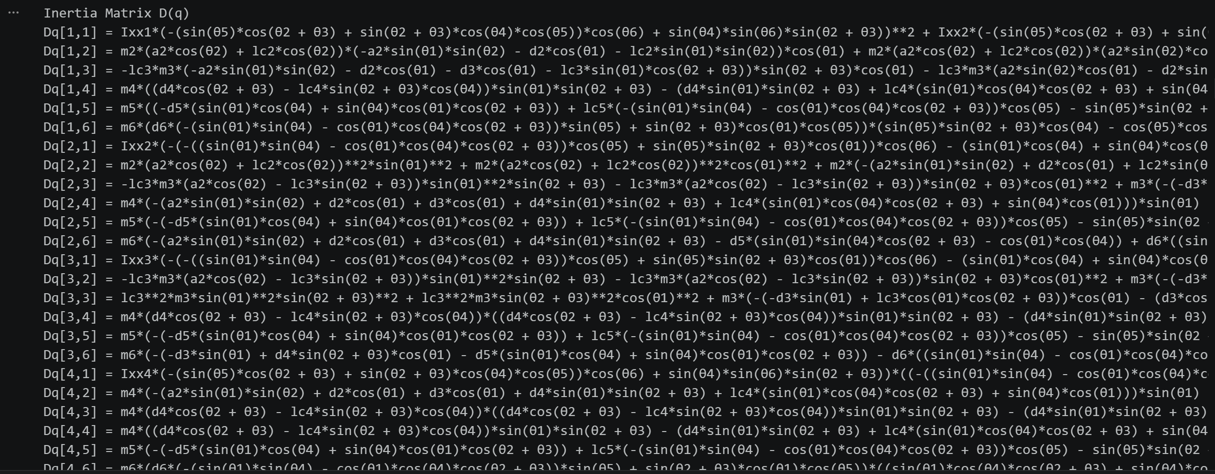
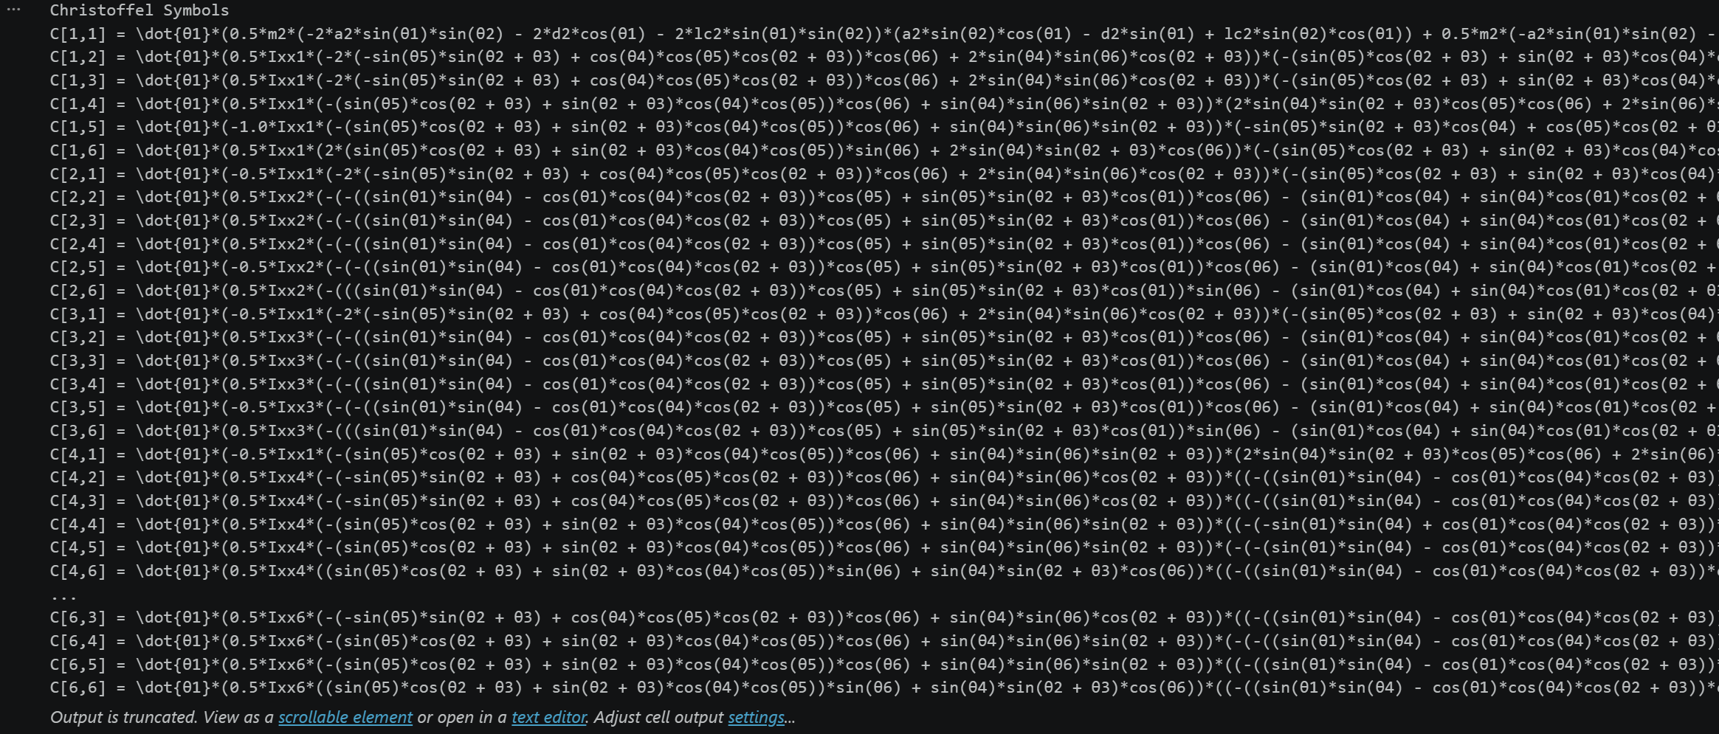
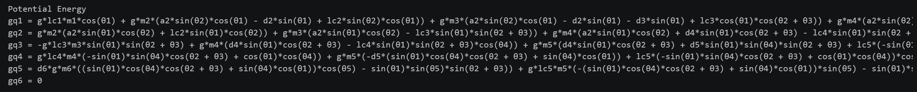
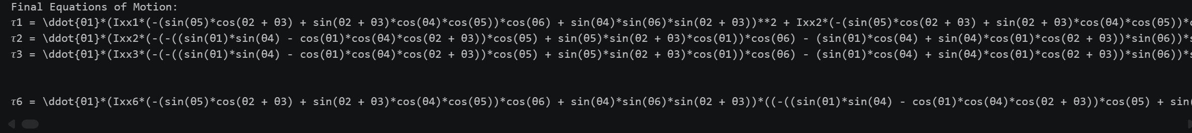
Full Equations of Motion

Slide 13
Mujoco Inverse Kinematics

Slide 14
References
[1] https://colab.research.google.com/github/google-deepmind/mujoco/blob/main/python/tutorial.ipynb
[2] https://alefram.github.io/posts/Basic-inverse-kinematics-in-Mujoco
[3] https://robotics101-viscircuit.web.app/robotics/dh-model

